Slide 1
Progress Report
Multiple Drones Coordination
FAU CS & CE EGN 4950C
DATE
Group 32: Brenden Martins
Matthew Wyatt Matthew Paternoster Tutku Gizem Guder Tarek Kayali

Slide 2
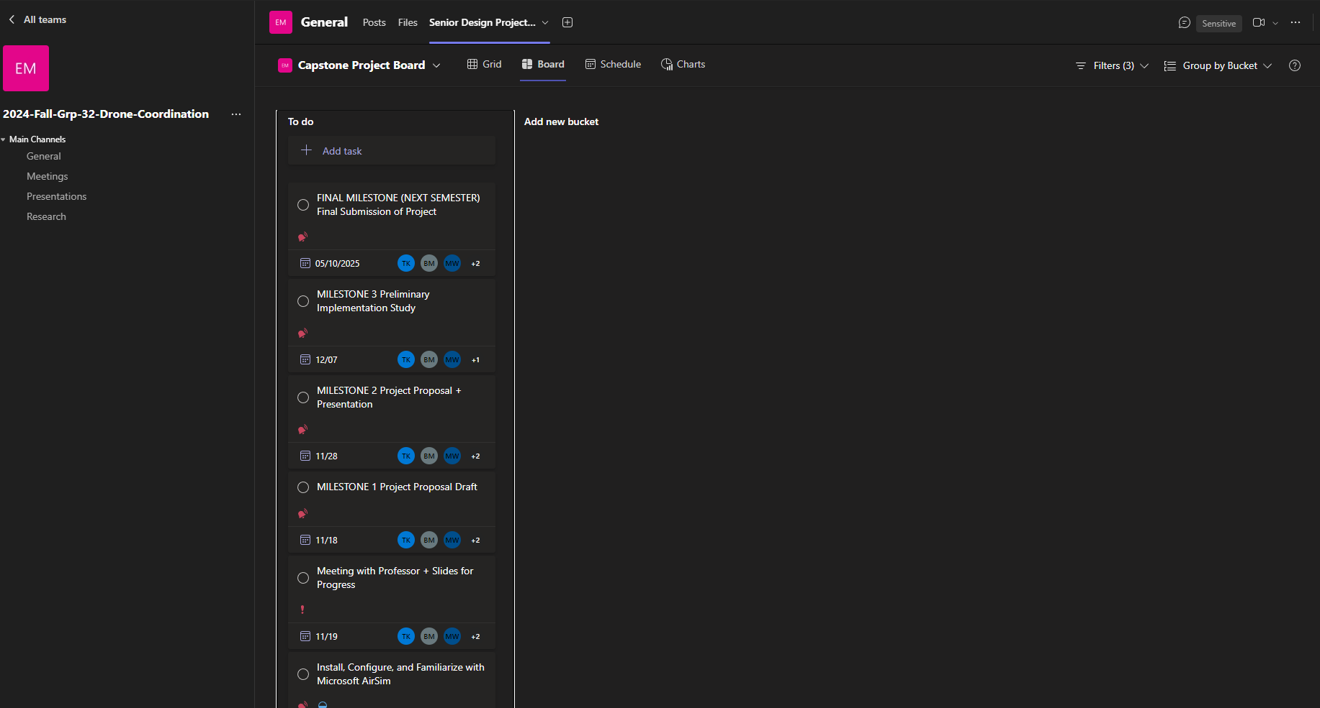
Microsoft Teams
Multiple Drones Coordination
FAU CS & CE EGN 4950C
Brenden Martins
Microsoft Teams was created alongside the project planner tab with tasks set.
Utilizing Microsoft Teams allows us to have centralized communication, task management and scheduling, collaboration and resource sharing, and accountability and transparency.

Slide 3
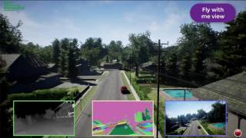
AirSim
Multiple Drones Coordination
FAU CS & CE EGN 4950C
Brenden Martins, Matthew Paternoster
Progress Made:
Successfully installed and setup AirSim on computer.
Familiarized with basic simulation controls and environment setup
Next Steps:
Engage with comprehensive AirSim tutorials to understand advanced features and capabilities.
Developing and testing multiple scenarios by creating various disaster scenarios to test drone operations and coordination.
3D Sim

Slide 4
Potential Challenges with Airsim
Multiple Drones Coordination
FAU CS & CE EGN 4950C
Matthew Paternoster
Challenges:
Potential difficulties in integrating AirSim with other subsystems like ROS and custom algorithms.
Managing simulation performance when scaling up to multiple drones and detailed environments could strain hardware resources.
Encountering bugs or stability issues within the simulation environment that could disrupt testing and development.

Slide 5
Individual Plan
Multiple Drones Coordination
FAU CS & CE EGN 4950C
Matthew Paternoster
Matthew Paternoster - User Interface Subsystem
Objective:
Develop as intuitive, user-friendly mobile application for real-time monitoring and control of the drone fleet.
Develop Front-End Components:
Integrate real-time data feeds for target detection and drone status.
Integrate with Back-End Systems:
Connect the app to data management and communication subsystems and ensure secure and efficient
data transmission.
Testing And Feedback:
Conduct usability testing and gather feedback and iterate on the design for improvements.

Slide 6
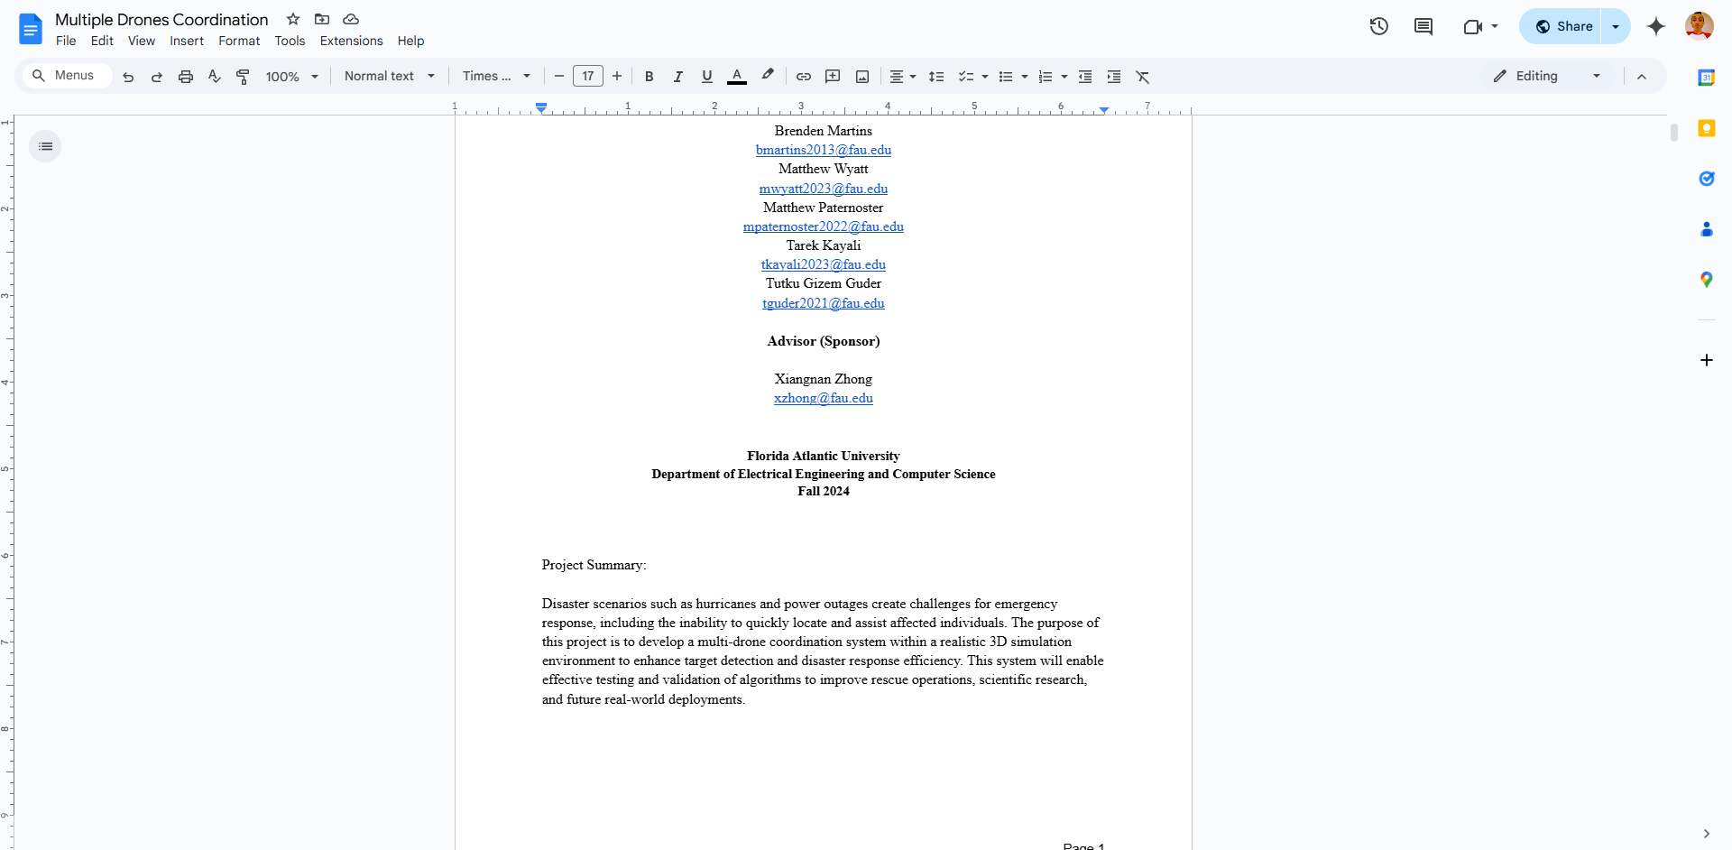
Progression
Multiple Drones Coordination
FAU CS & CE EGN 4950C
Brenden Martins
Microsoft AirSim
Installing and familiarizing with AirSim
Watching videos and tutorials
Reading through the AirSim Github
Microsoft Teams
Updating tasks on the project planner board
Creating posts with information frequently
Project Proposal Draft
Collaborating on Google Docs

Slide 7
Individual Plan
Multiple Drones Coordination
FAU CS & CE EGN 4950C
Brenden Martins
Brenden Martins - Simulation Management Subsystem
Responsibilities
Configure and optimize the AirSim simulation environment.
Design and test realistic 3D terrains, weather conditions, and obstacles.
Ensure integration with multi-drone algorithms for seamless operation.
Milestones
Install and configure AirSim; familiarize with API.
Develop and test terrains (urban, forest, disaster scenarios).
Integrate collision avoidance algorithms and run initial tests.
Finalize and validate simulation results with all subsystems.

Slide 8
Individual Plan
Multiple Drones Coordination
FAU CS & CE EGN 4950C
Tutku Gizem Guder
Tutku Gizem Guder - Target Detection Subsystem
Responsibilities
Integrate object detection and tracking algorithms to ensure effective identification of individuals or hazards.
Set up Microsoft AirSim to simulate realistic disaster scenarios.
Select suitable algorithms (YOLOv5) for object detection and SORT for tracking.
Milestones
Install and Configure Airsim using Unreal Engine
Research Models and Algorithms
Simulate the Process
Fine-tune the Model
Add Complex Scenario
Testing

Slide 9
Progression
Multiple Drones Coordination
FAU CS & CE EGN 4950C
Tutku Gizem Guder
Done
Install and Configure Airsim using Unreal Engine
Research Models and Algorithms
Doing
Simulate the Process
To Do
Fine-tune the Model
Add Complex Scenario
Testing

Slide 10
Potential Challenges with the Subsystem
Multiple Drones Coordination
FAU CS & CE EGN 4950C
Tutku Gizem Guder
Challenges:
Combining Microsoft AirSim, YOLOv5, and tracking algorithms may pose compatibility and integration issues.
Synchronizing real-time data from simulated environments to the detection system.
Ensuring the detection model remains robust across diverse scenarios.
Achieving the right balance between detection accuracy and processing speed.
Ensuring that the system processes sensor data fast enough for real-time applications during disaster response.

